Slide 1
CHEM-E5140 Materials Characterization Laboratory Course Auger + SIMS Course summary 12.05.2025

Slide 2
Auger Spectroscopy
Auger electrons were named after Pierre Auger who, together with Lise Meitner, discovered Auger electron emission in 1920s. Leng, Yang. Materials Characterization : Introduction to Microscopic and Spectroscopic Methods, John Wiley & Sons, Incorporated, 2013. ProQuest Ebook Central, http://ebookcentral.proquest.com/lib/aalto-ebooks/detail.action?docID=1333091. Created from aalto-ebooks on 2018-11-26 01:42:43.
E. Haimi, SEM lecture

Slide 3
Energy Dispersive X-ray Spectroscopy (EDS) Characteristic X-rays
Incident electron beam hits the surface
• Produces core-level vacancy
• Relaxation of the ionised state by emission of an x ray photon
• Detection of an x ray
W.R. Runyan, T.J. Saffner, Semiconductor measurements
and instrumentation, McGraw Hill, 2nd Ed. 1998, Chapter 14.

Slide 4
Auger Electron Spectroscopy (AES)
Auger electron emission
The relaxation of the ionized state by an Auger electron

Slide 5
Auger electrons
Rare event
1 Auger electron for every 1000 secondary electrons (SEM)
-> development for a special detectors
• Auger transition is more probable
with light elements
– starting Li ->
– Observes well C, N and O
– Are often also contaminants
– Requires ultra high vacuum (UHV)
W.R. Runyan, T.J. Saffner, Semiconductor measurements
and instrumentation, McGraw Hill, 2nd Ed. 1998, Chapter 14.

Slide 6
Auger electron terminology
Auger electrons originated from different electron shells
are labelled with three letter: ABC
A = initial ionization shell
B = replacement electron shell
C = Auger electron shell
Most probable are KLL, LMM, MNN
W.R. Runyan, T.J. Saffner, Semiconductor measurements
and instrumentation, McGraw Hill, 2nd Ed. 1998, Chapter 14.

Slide 7
High surface sensitivity
Incident electron beam 3 -5 keV
• Auger electrons are adsorbed into
the solid sample
• Only few monolayers detected
– > High surface sensitivity
W.R. Runyan, T.J. Saffner, Semiconductor measurements
and instrumentation, McGraw Hill, 2nd Ed. 1998, Chapter 14.

Slide 8
Auger equipment
The cylindrical mirror analyser
Applied negative voltage for the outer plate
• Inner plate to ground
• Applied a voltage ramp by time
• Maximize the detection of Auger electrons

Slide 9
Auger spectroscopy
What can I analyse?
Samples
When interested of the outer most monolayers on a surface
• Interest of light elements
• Or contamination (organic)
• Samples need to tolerate and be suitable for ultra high vacuum!
• Is non-destructive, however, needs sample preparation, so often the sample is lost

Slide 10
Surface cleaning
Sputter etching
Only few monolayers, often we have organic impurities
Ionized inert gas (Ar⁺) with focus beam of 3-5 keV
The removal rate of material ~10 nm per minute
W.R. Runyan, T.J. Saffner, Semiconductor measurements
and instrumentation, McGraw Hill, 2nd Ed. 1998, Chapter 14.

Slide 11
Surface cleaning
Sputter etching
Example of
AlGaAs:SF6
Having S and F impurities +
organic contamination (C,O)
After sputter etching, the
peaks of Ga, As and Al more
visible
Also a small indication of Ar
W.R. Runyan, T.J. Saffner, Semiconductor measurements
and instrumentation, McGraw Hill, 2nd Ed. 1998, Chapter 14.

Slide 12
Data analysis
A derivative display is
used to help in the
characterization
Data obtained from the experiment
- Has high background of
secondary electrons
W.R. Runyan, T.J. Saffner, Semiconductor measurements
and instrumentation, McGraw Hill, 2nd Ed. 1998, Chapter 14.

Slide 13
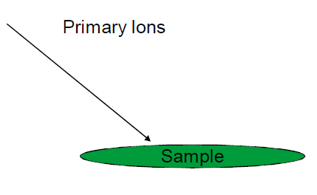
Secondary Ion Mass Spectroscopy –SIMS
Ions are also charged
particles (like electrons)
Can be deflected with
electric or magnetic field
Focused small ion probe at
the sample surface
Incident ions are capable to
knock of secondary ions

Slide 14
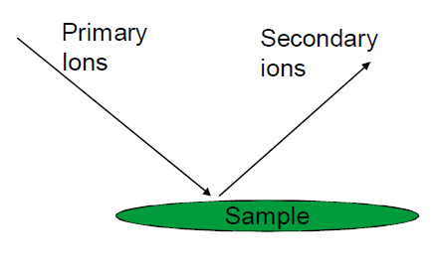
SIMS
• Provides
– Detection of All element (also
H and other light ones)
– Different Isotopes
– Detection for one to two top atomic layers (< 1 nm)
– Detection of elements in Concentration as low as 10⁻⁶ at% possible
[Auger 0.01–0.1 at% and XPS 0.1–1 at %]
• Many of the non Charged products -> cannot be detected

Slide 15
Instrumentation
Ultra high vacuum needed
Electromagnetic lenses
Y. Leng, Materials Characterization : Introduction to Microscopic and Spectroscopic Methods, Publisher, Wiley-VCH

Slide 16
SIMS
• Ions
– Large mass
O⁻ ion 10 000 more mass than
electron
– Can be destructive for the
surface
– “Sand blaster”
• Ions commonly used
Ar⁺, Xe⁺, O²⁺, Ga⁺, Cs⁺
Y. Leng, Materials Characterization : Introduction to Microscopic and Spectroscopic Methods, Publisher, Wiley-VCH

Slide 17
SIMS
Is the method destructive?
• Method still under development [especially data analysis] - > qualitative method (currently)
• Two different modes of operation
– Dynamic SIMS
• Destructive
• High flux of primary ions (sputtering)
• Similar to Auger and XPS
– Static SIMS
• Non-destructive
• Low flux of primary ions [changing the analysis place]
Y. Leng, Materials Characterization : Introduction to Microscopic and Spectroscopic Methods, Publisher, Wiley-VCH

Slide 18
SIMS
• Not a measure of mass but
rather mass to charge ratio
• Sensitive
– Very little background
– Depth of 1-2 nm (from surface)
– Ppm or Ppb detection limits
– Qualitative technique
Boron doped Silicon
Y. Leng, Materials Characterization : Introduction to Microscopic and Spectroscopic Methods, Publisher, Wiley-VCH

Slide 19
SIMS
Analysis
• Mass-to-charge ratio
– Individual ions
– Ion clusters
– Molecular fragments
• Spectrum of positive or negative ions
• More complex than(Auger/XPS),
more peaks
Y. Leng, Materials Characterization : Introduction to Microscopic and Spectroscopic Methods, Publisher, Wiley-VCH

Slide 20
Course Summary
The “first lecture” 10.3.2025
Imaging Method
SEM, AFM
Elemental Analysis
EDS Raman XPS (Auger) SIMS
Surface properties
AFM, SEM, SIMS
Four Probe Resistivity and Hall
Measurement in semiconductors

Slide 21
The techniques for the exam
Scanning Electron Microscopy(SEM), Four Probe Resistivity and Hall, X-ray Diffraction (XRD), Raman Spectroscopy, Atomic Force Microscopy(AFM)

Slide 22
Oral Exam
First task
• Describe a method
– All the methods learned at the course are in my doctoral hat –
you will take one with randomly picking (chit in which the method will be mentioned) and answer to questions:
1. What does the method provide and how does it work? (0-4 p.)
2. What kind of samples can be analysed? (0-4 p.)
3. What could a possible result look and how is it analysed? (0-4 p.)

Slide 23
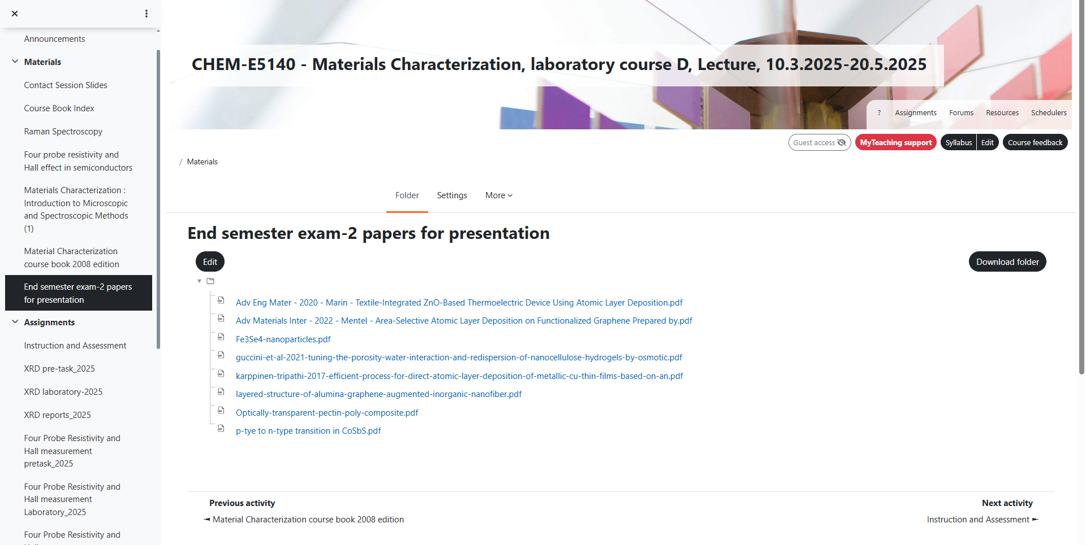
Oral Exam
Second task
• A case study:
– Real case (from a published paper):A material has been created
How the sample is synthesized (0-2p)
What methods are used to characterization and why?
(0-10 p.)
3. Explain the data
(0-10 p.)
4. Your own idea about characterization (enough (Why ?) or need more ? If need what method could be used and why ? (0-2 p)

Slide 24
Exam practice
Case:
Al and Ti co-doped zinc oxide (ATZO) nano-structured thin films with 1 at % Al and 0.1 at % Ti were deposited on glass substrate via sol–gel technique.
How would you analyse?
Journal of Alloys and Compounds 657 (2016) 296e301

Slide 25
Exam practice
Interpretation of the following data…
What does it tell you?
Fig. 1 Al–Ti co-doped ZnO (ATZO) thin film (a) and JCPDS card number 89-1397 (b) [standard hexagonal ZnO] .
What method?

Slide 26
Fig. 2. ZnO (a), Al dobed ZnO (AZO) (b), ATZO thin films (c) and the cross-sectional image of the ATZO thin film (d).

Slide 27
Fig. 3. Surface roughness and grain size of the
ZnO, AZO and ATZO thin films.

Slide 28
Fig. 4. (a) ZnO, (b) AZO and (c) ATZO thin
films

Slide 29
Fig.5. ZnO (a), AZO (b) and ATZO (c) thin
film

